Slide 1
Hand Gesture simple User Interfacing
P.R. Nandhakumar (21009104060)
E.H. Shyam Sundar (21009104104)
Verghese Koshy Puthukkeril (21009104123)
Guided by :
S.Malathi, M.E.,(Ph.D.)
Professor CSE Dept

Slide 2
OBJECTIVE
To make a simple hand gesture system which will take the input from the users hand movements.
The movement can start from a basic click operation, to drag the mouse pointer across the screen.

Slide 3
ABSTRACT
Problem addressed
The requirement of simple, yet sophisticated user interface has driven the IT professionals to develop enhanced devices ranging from the basic punch-card system to the widely used keyboard, mouse and the latest touch screen technology. These improved gadgets basically reduce the invisible barrier between the user and system. However, these devices have their limitations and inconvenient for the user to interact with the system.
Method used
To simplify the procedure, a new system is developed which takes human gestures into consideration to perform the corresponding operation. A new software is developed to capture the hand gesture from the user through web camera.
Performance
The proposed hand gesture system is effective, but not enough so as to eliminate the need for a keyboard and a mouse.

Slide 4
MODULES IN THE SYSTEM
Image Capture and Correction
Device Capture module
Basic Noise Correction Model
Automatic Contrast and Brightness Adjustment
Image Hand Detection
Edge detection and stereotype matching
Distance analysis and Calculation System.
Motion Detection module
Gesture detection module based on fuzzy logic
Event Triggering
System Event triggering to perform corresponding operation.

Slide 5
System requirements
HARDWARE CONFIGURATION:
Processor :Intel Processor with support for better parallel processing.
Hard disk space of 7 GB (Stand-alone application 55MB)
RAM capacity of 512 MB or more
Web Camera
SOFTWARE CONFIGURATION:
Platform : Windows 7 and above
Frame Work: OpenCV, TBB, Boost Threading, VS2010.
Device driver for web camera

Slide 6
LITERATURE SURVEY

Slide 7
Sl. No | Title/Year | Author Name | Problem Addressed | Methodology | Conclusion
1 | Real-time natural hand gestures / 2011 | Beifang Yi, Frederick C. Harris Jr., Ling Wang, and Yusong Yan | In human–computer interaction (HCI) applications, traditional Devices, such as keyboard and mouse, can become Cumbersome and unsuitable. | Vision-based HCI hand-gesture analysis and recognition studies require large numbers of a variety of gestures as input and a virtual hand as output to display the results. | The current hand model can’t represent different hand sizes (for example, thin or thick), so we plan to calibrate it to different representative hand shapes.
2 | Computer Vision Face Tracking For Use in a Perceptual User Interface/2008 | Gary R. Bradski, Santa Clara | Tracker should be able to serve as part of a user interface that a computer might routinely be expected to carry out. Hence the algorithm that uses the tracker must be fast and simple. | The modified algorithm is called the Continuously Adaptive Mean Shift (CAMSHIFT) algorithm | CAMSHIFT is a simple, computationally efficient face and colored object tracker designed a highly efficient face tracking algorithm rather than a more complex, higher MIPs usage algorithm.
3 | Orientation Histograms for Hand Gesture Recognition/ December 2008 | William T. Freeman, Michal Roth | The trackball, the joystick, and the mouse are extremely successful devices for hand-based computer input. Yet all require that the user hold some hard-ware. We seek a visually based method which will be free of gloves and wires. | Method to recognize hand gestures, based on a pattern recognition technique developed by employing histograms of local orientation. We use the orientation histogram as a feature vector for gesture classification and interpolation. | A simple pattern recognition technique to the problem of hand gesture recognition is found out. The methods are image based, simple, and fast. We have implemented a real-time version, using an ordinary workstation with no special hardware beyond a video digitizer.

Slide 8
Sl. No | Title/Year | Author Name | Problem Addressed | Methodology | Conclusion
4 | Hand Tracking and Gesture Recognition for Human-Computer Interaction 18 May 2005 | Cristina Manresa, Javier Varona, Ramon Mas and Francisco J. Perales | The algorithm used aims at the control of a videogame based on hand gesture recognition. This goal implies the restriction of real-time response and the use of unconstrained environments. | This algorithm is based on three main steps: hand segmentation, hand tracking and gesture recognition from hand features. | We have proposed an algorithm based on skin colour hand segmentation and tracking for gesture recognition from extracted hand morphological features.
5 | Hand Gesture Recognition using blob Detection for immersive projection display system. 2005 | Hasup lee, Yoshisuke Tateyama and Tetsuro Ogi | Developed a vision interface immersive projection system, CAVE in virtual reality research field using hand gesture recognition with computer vision techniques. | A background image was subtracted from current image frame of webcam and we convert the color space of the image into HSV space. | hand gesture recognition was developed. We presented the framework for hand gesture recognition and it can be applied for other environment, too. It used built-in webcam of notebook PC so does not need high cost devices.
6 | Real-time Hand Tracking and Finger Tracking for Interaction/2003 | Shahzad Malik | The problem is still far from being solved since the hand exhibits significant amounts of articulation and self-occlusion that cause difficulties with existing algorithms. | Stereo vision hand tracking system that can be used for interaction purposes. The system can track the 3D position and 2D orientation of the thumb and index finger of each hand without the use of special markers or gloves | A vision-based hand tracking system that does not require any special markers or gloves and can operate in real-time on a commodity PC with low-cost cameras. Specifically, the system can track the tip positions of the thumb and index finger for each hand.

Slide 9
Design
Architecture diagram, Data flow diagram, sequence diagram.

Slide 10
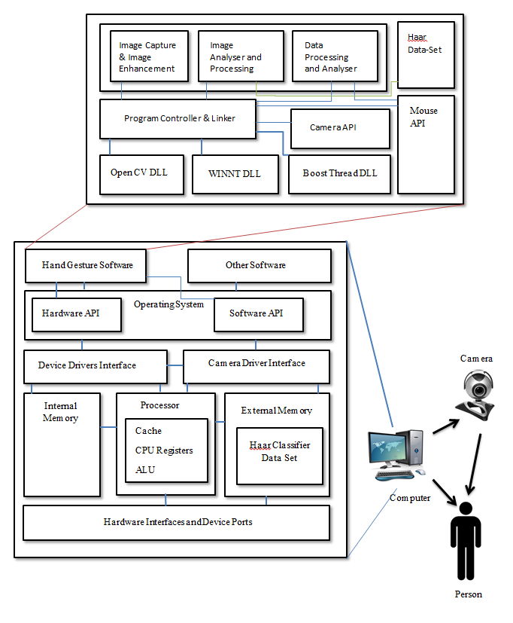
ARCHITECTURE DIAGRAM
This diagram specifies the overview of the whole system.
Which includes both internal hardware and software.
And also the application software which was designed to run over the system.
The

Slide 11
LEVEL 0 DATA FLOW DIAGRAM
Video file
Transfer video
feed
Recognize Hand Gesture
Event
System
trigger
Transfer gesture
Gesture resource file
data set

Slide 12
LEVEL 1 DATA FLOW DIAGRAM
Video file
Transfer video
feed
Detection & Analysis of hand information
Produce Hand
Information
Hand
Event
System
info
trigger
Gesture resource file
Transfer gesture
data set

Slide 13
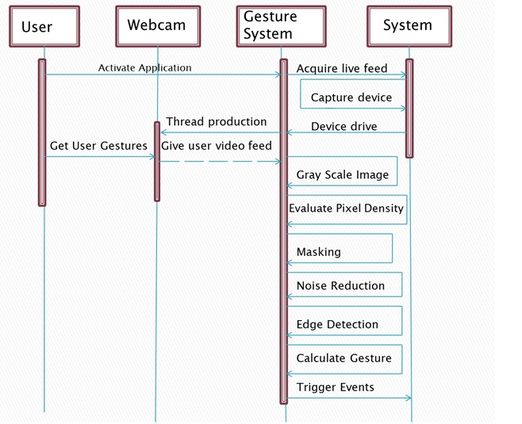
SEQUENCE DIAGRAM
Overview of the sequence flow of control and data amongst the various components.
It gives a rough idea of the internal working of the system.

Slide 14
Implementation
Primary three system modules

Slide 15
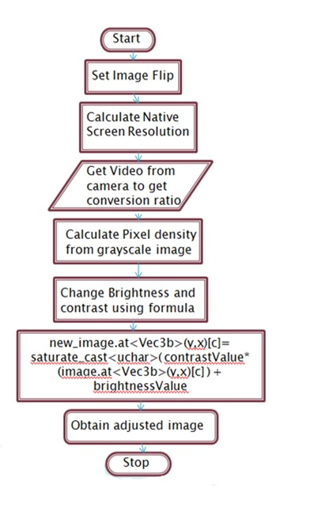
FLOW DIAGRAM - Image Capture and Correction
Check the image if it is mirror ‘or’ not.
Get native screen resolution.
Get camera resolution. And use both resolution to get conversion ratios.
Calculate pixel density.
Using the pixel density adjust brightness and contrast.
Set the new image values.
Obtain the new adjusted image for the next module.

Slide 16
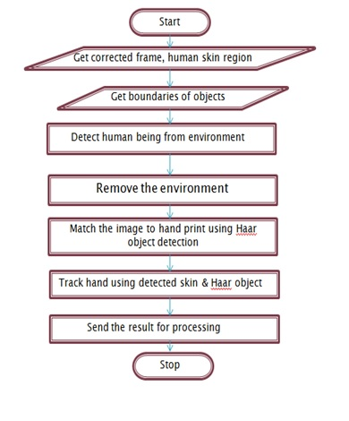
FLOW DIAGRAM - Image Hand Detection
We get the frame from the previous process.
Get the skin and edge.
Detect what is human and what is not.
Based on the above remove most of the environment.
Match hand using the Haar-set.
Track the hand and gestures.
Send the results to next module

Slide 17
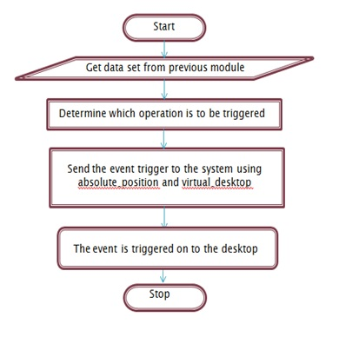
FLOW DIAGRAM - Event Triggering
Get the image from the previous module.
Determine the event which has to be triggered.
Set the event based on absolute position on the main desktop.
Trigger the event on the main desktop by pushing the event to the event buffer.

Slide 18
Testing
General unit testing

Slide 19
Test Case – Image enhancement
Test Case ID | Input Video Feed | Expected output Video Feed | Obtained output | Pass/Fail
T1 | 50% Brightness | 50%-57% Brightness | 53% Brightness | Pass
T2 | 25% Brightness | 50%-57% Brightness | 51% Brightness | Pass
T3 | 15% Brightness | 50-57% Brightness | 40% Brightness | Fail
T4 | 10% Brightness | <50% Brightness | 28% Brightness | Pass
T5 | 75% Brightness | 50%-57% Brightness | 55% Brightness | Pass
T6 | 85% Brightness | 50%-57% Brightness | 62% Brightness | Fail
T7 | 90% Brightness | >50% Brightness | 72% Brightness | Pass

Slide 20
Test Case – Image Analysis & processing
Test Case ID | Input Video Feed | Expected output | Obtained output | Pass/Fail
T1 | 50% Brightness with fist | Detection of the fist in <10 seconds | 6 seconds | Pass
T2 | 50% Brightness with palm | Detection of the fist in <10 seconds | 8 seconds | Pass
T3 | 50% Brightness without fist | Should not detect any fist for <5 minutes | 6 minutes | Pass
T4 | 50% Brightness without palm | Should not detect any palm for <5 minutes | 6 minutes | Pass
T5 | Non-ideal environment without fist or palm in frame | Should not detect any palm for <10 minutes | False detection of object within 4 minute. | Fail

Slide 21
Test Case – Event triggering Module
Test Case ID | Input | Expected Output | Obtained Output | Pass/Fail
T1 | Single Left Click | Single Left Click | Single Left Click | Pass
T2 | Double Left Click | Double Left Click | Double Left Click | Pass
T3 | Single Right Click | Double Left Click | Single Right Click | Fail
T4 | Double Right Click | Double Right Click | Double Right Click | Pass

Slide 22
Screenshots

Slide 23
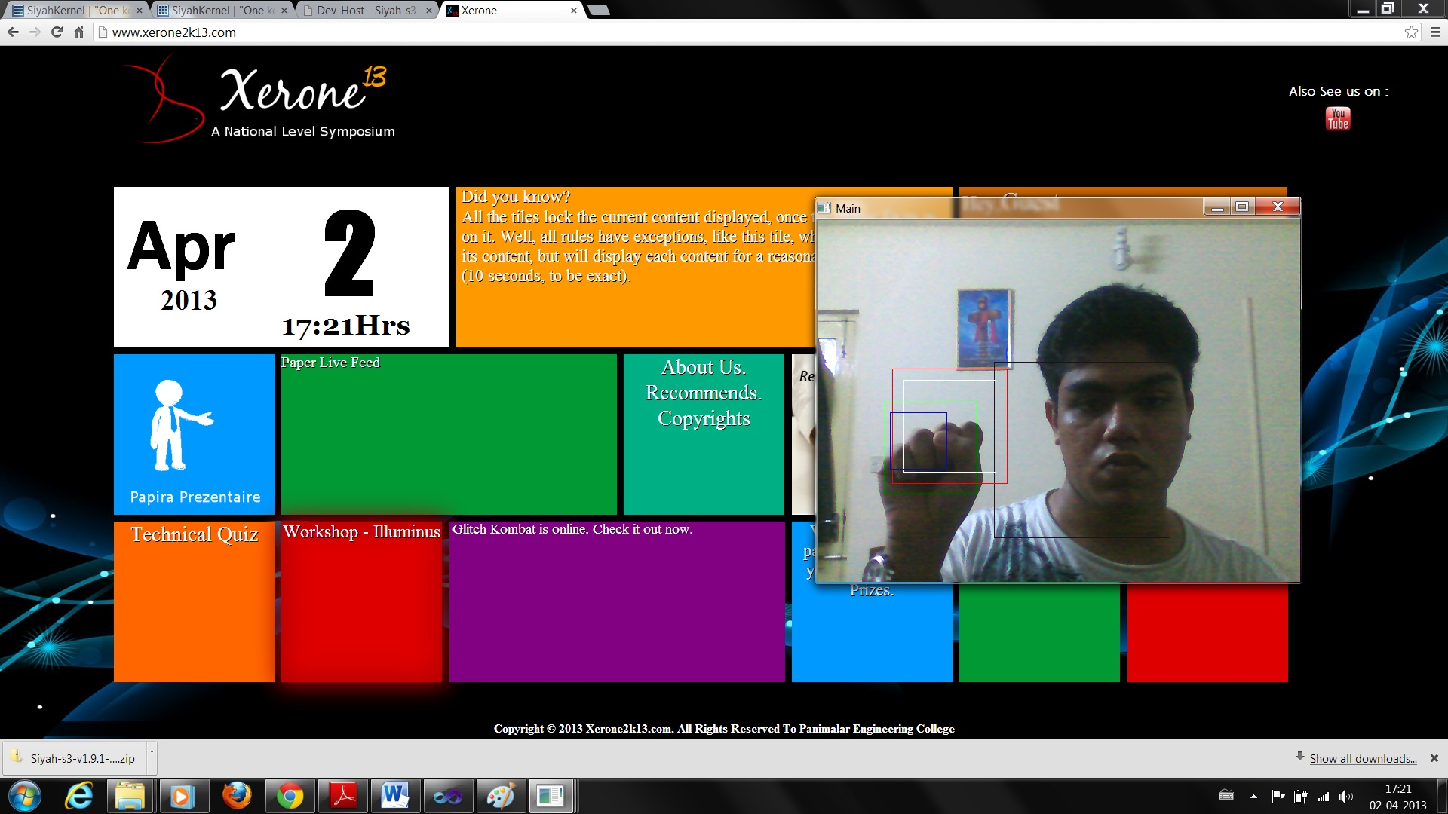
Mouse Movement Tracking

Slide 24
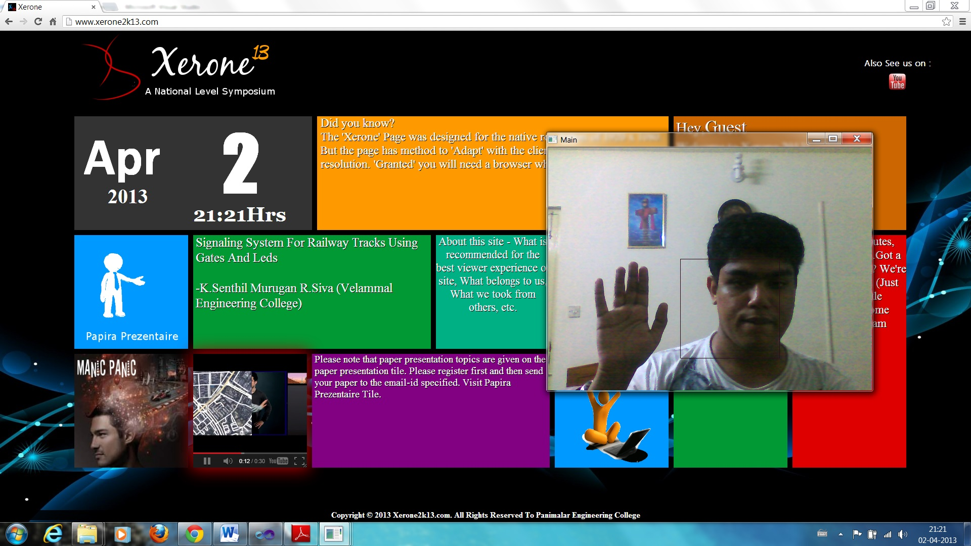
Mouse Click Operation

Slide 25
CONCLUSION
The current system is capable of tracking and performing single left click operation on any object which is available on the system UI.
Since the mouse API on the application pushes the information onto the buffer, the event can be triggered to any application which is running on the system, which includes both Operating system software and application software.
The proposed system is very primitive and performs a simple left click gesture.

Slide 26
FUTURE ENHANCEMENT
The HAAR dataset which is used for the detection is very primitive and, hence, the detection rate is slow and false positives are still a possibility. So the future system will have a better dataset for the HAAR detection of fist and palm.
The current system has incorporated methods to detect and analyse more complex gestures like variation types of click operation, pinch zoom etc.
The algorithm which is used for detection and tracking still needs improvement in accuracy and speed.

Slide 27
REFERENCES
Beifang Yi, Frederick C. Harris Jr., Ling Wang, Yusong Yan (2005) ‘Real-Time Natural Hand Gestures’, Proceedings of IEEE CS and the AIP, pp. 92-97
Cristina Manresa, Javier Varona, Ramon Mas, Francisco J. Perales (2005) ‘Hand Tracking and Gesture Recognition for Human-Computer Interaction’, Journal of Electronic Letters on Computer Vision and Image Analysis, pp. 96-104.
Kenji Oka, Yoichi Sato, Hideki Koike (2002) ‘Real-Time Fingertip Tracking and Gesture Recognition’, Proceeding of IEEE Computer Graphics and Applications, pp. 64-71.

Slide 28
Mohamed Alsheakhali, Ahmed Skaik, Mohammed Aldahdouh, Mahmoud Alhelou (2011) ‘Hand Gesture Recognition System’, submitted at The Islamic University of Gaza.
William T. Freeman, Michal Roth (1994) ‘Orientation Histograms for Hand Gesture Recognition’, Proceeding of IEEE International workshop on Automatic Face and Gesture Recognition.
Rafiqul Zaman Khan and Noor Adnan Ibraheem (2012) ‘HAND GESTURE RECOGNITION: A LITERATURE REVIEW’, Proceeding of International Journal of Artificial Intelligence & Applications (IJAIA), Vol.3, No.4, pp. 161- 174.

